Slide 1
人工智能引论
宋睿华
中国人民大学人工智能学院

Slide 2
人工智能与听觉
听觉基础
语音的产生与感知
傅里叶变换从时域到频域
抽取声音特征
典型的听觉任务与模型

Slide 3
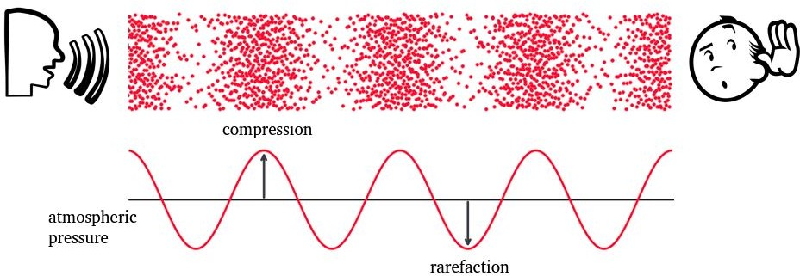
Sound wave

Slide 4
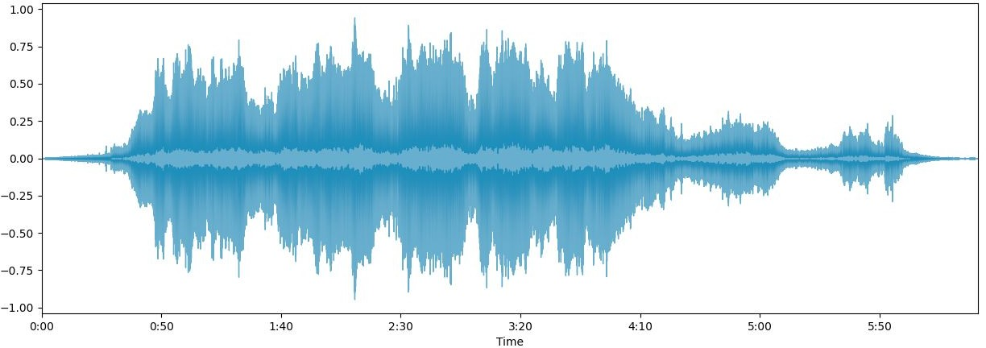
Waveform
Carries multifactorial information: Frequency, Intensity, Timbre

Slide 5
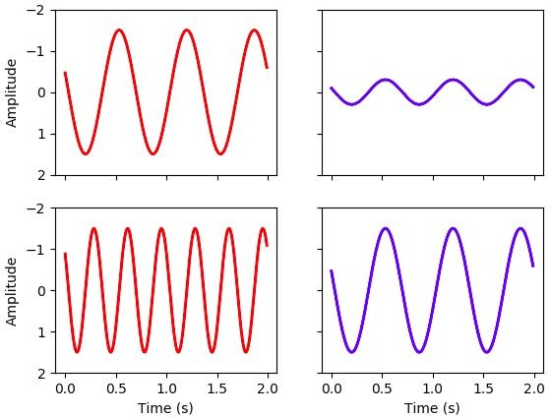
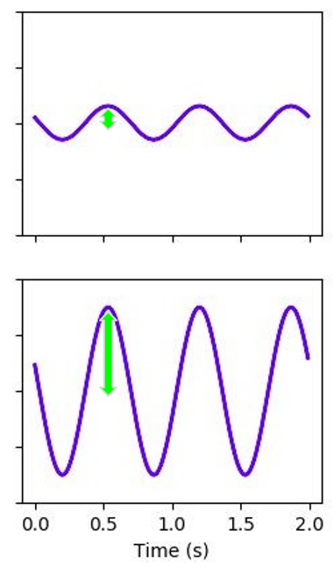
Frequency and amplitude
Frequency Amplitude
higher frequency -> higher sound
larger amplitude -> louder

Slide 6
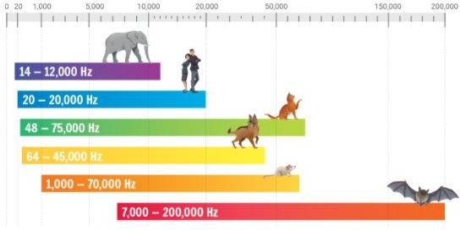
Hearing range

Slide 7
Pitch
Logarithmic perception
2 frequencies are perceived similarly if they differ by a power of 2

Slide 8
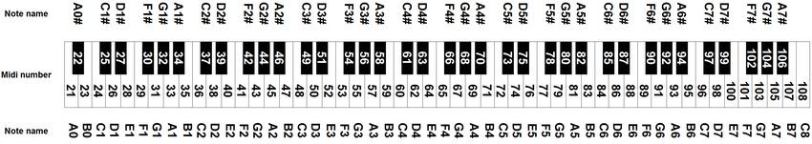
Midi notes
440 Hz
880 Hz

Slide 9
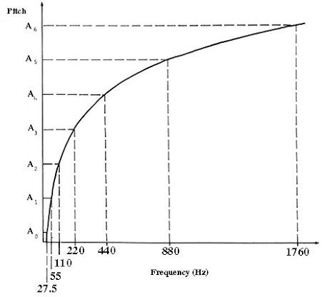
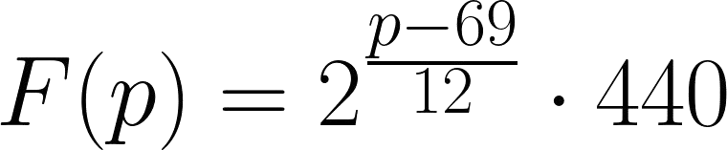
Pitch-frequency chart

Slide 10
Sound power
Rate at which energy is transferred
Energy per unit of time emitted by a sound source in all directions
Measured in watt (W)
Sound intensity
Sound power per unit area
Measured in W/m²

Slide 11
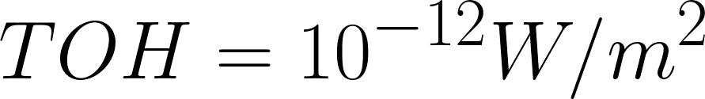
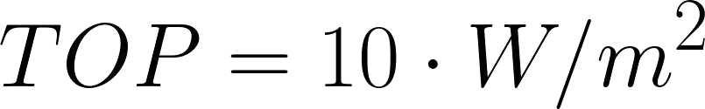
Threshold of hearing
Human can perceive sounds with very small intensities
Threshold of pain

Slide 12
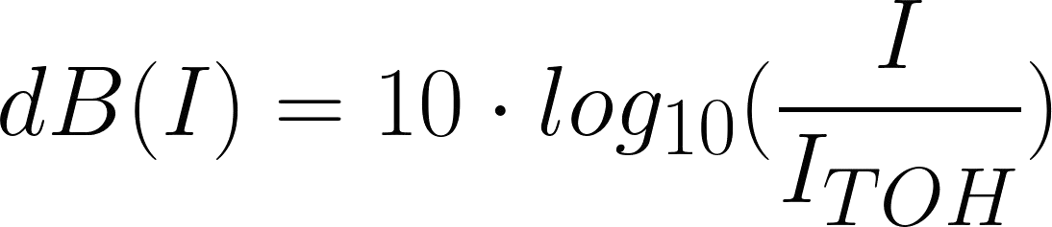
Intensity level
Logarithmic scale
Measured in decibels (dB)
Ration between two intensity values
Use an intensity of reference (TOH)

Slide 13
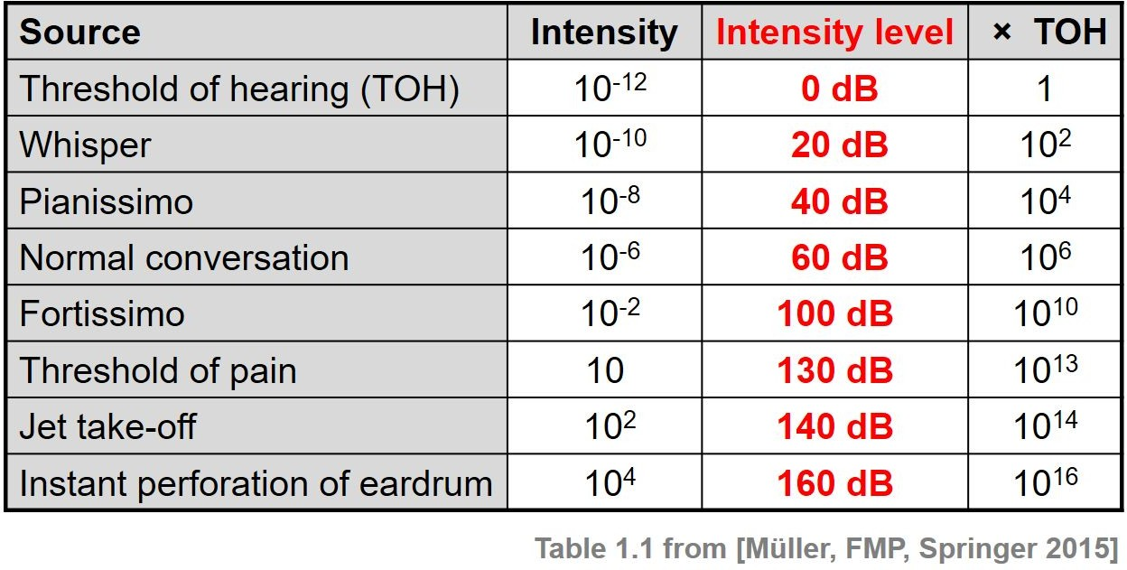
Intensity level
Notes:
Fortissimo强音
Pianissimo弱音

Slide 14
Analog signal
Continuous values for time
Continuous values for amplitude
Digital signal
Sequence of discrete values
Data points can only take on a finite number of values

Slide 15
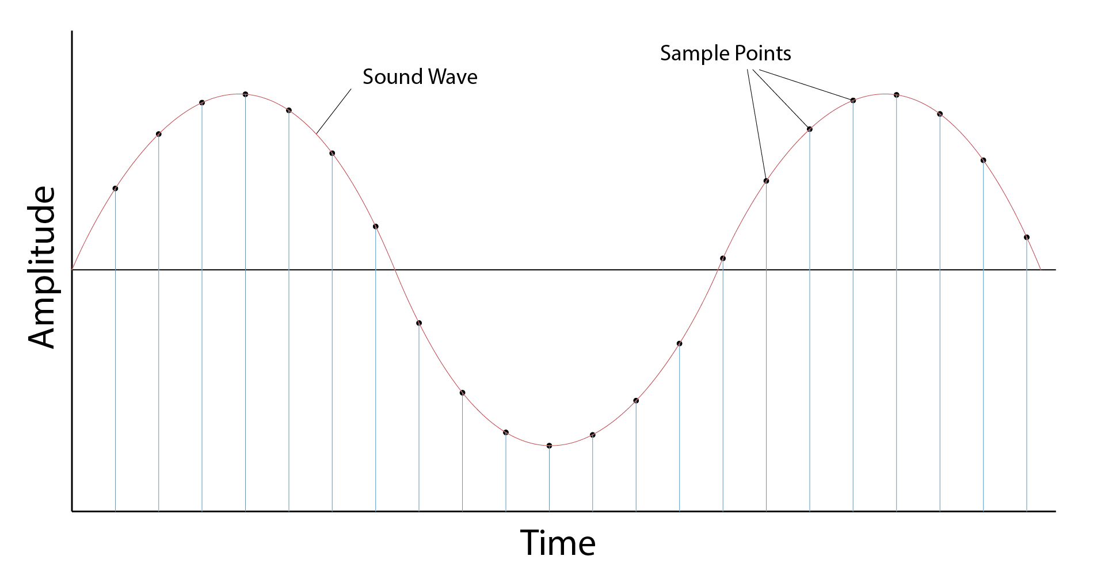

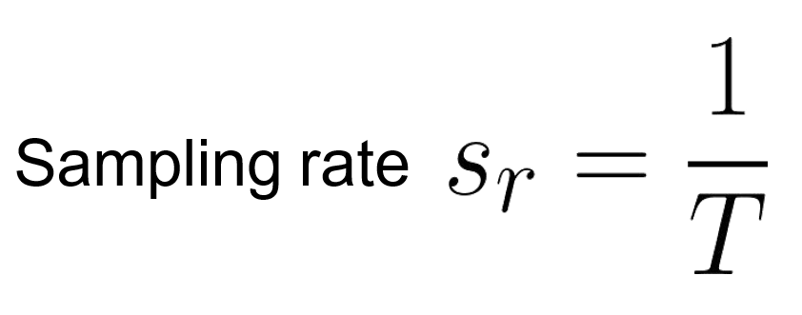
Sampling period
T

Slide 16
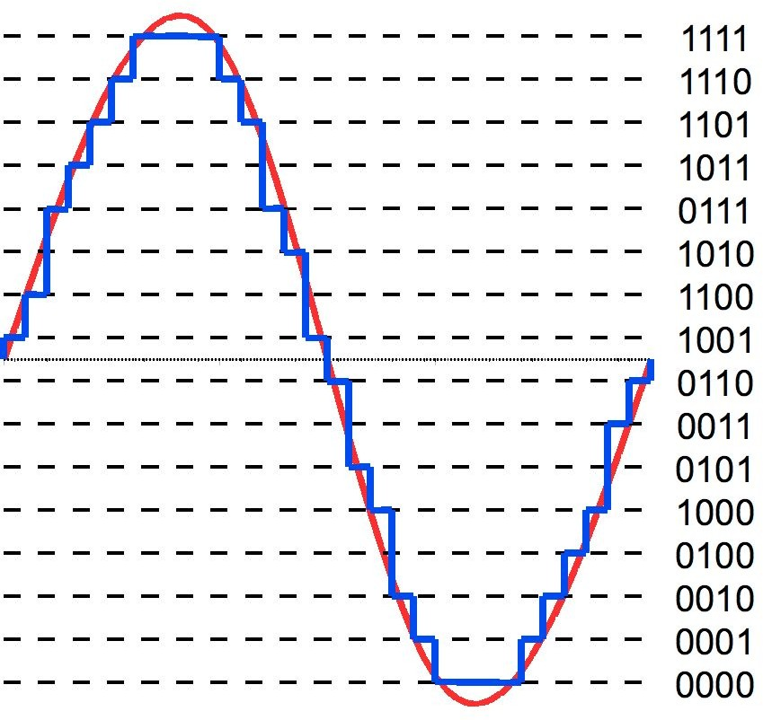
Quantization

Slide 17
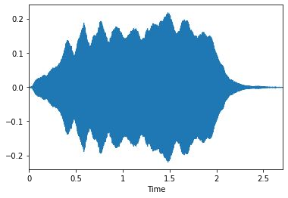
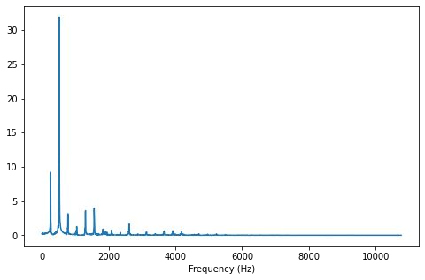
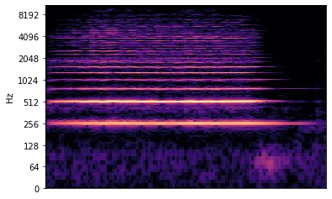
Signal domain
Time domain
Frequency domain
Time-frequency representation

Slide 18
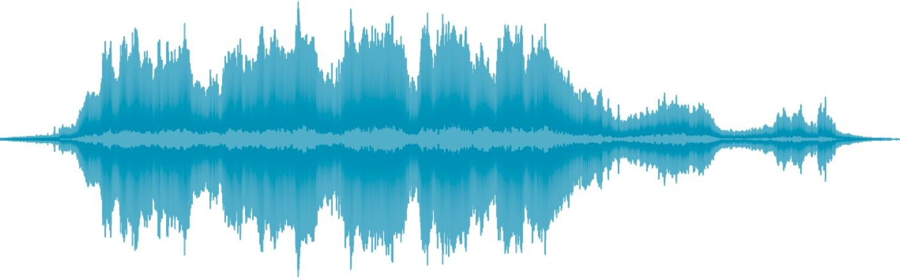
Non-overlapping frames

Slide 19
Overlapping frames
frame size K

Slide 20
Overlapping frames
hop length

Slide 21
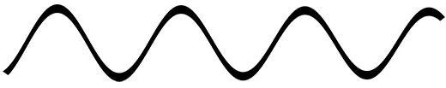
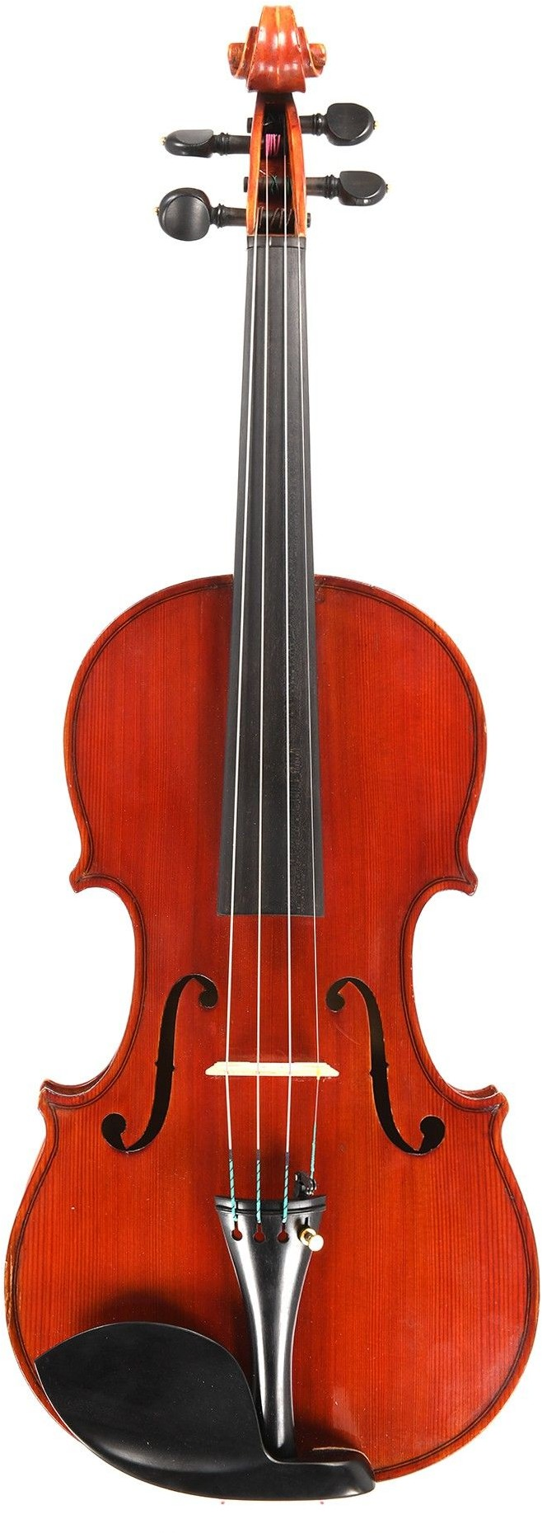
Frequency-domain feature pipeline
frame 1: sample 1 … 128
frame 2: sample 64 … 192
frame 3: sample 128 … 256
frame 4: sample 192 … 320
...
windowing
feature value/vector/matrix
aggregation (mean, median, GMM)
feature computation

Slide 22
人工智能与听觉
听觉基础
语音的产生与感知
傅里叶变换：从时域到频域
抽取声音特征
典型的听觉任务与模型

Slide 23
From time to frequency domain
FT

Slide 24
Deeper intuition
Compare signal with sinusoids of various frequencies
For each frequency we get a magnitude and a phase
High magnitude indicates high similarity between the signal and a sinusoid

Slide 25
Fourier transform: Step by step
Choose a frequency
Optimise phase
Calculate magnitude

Slide 26
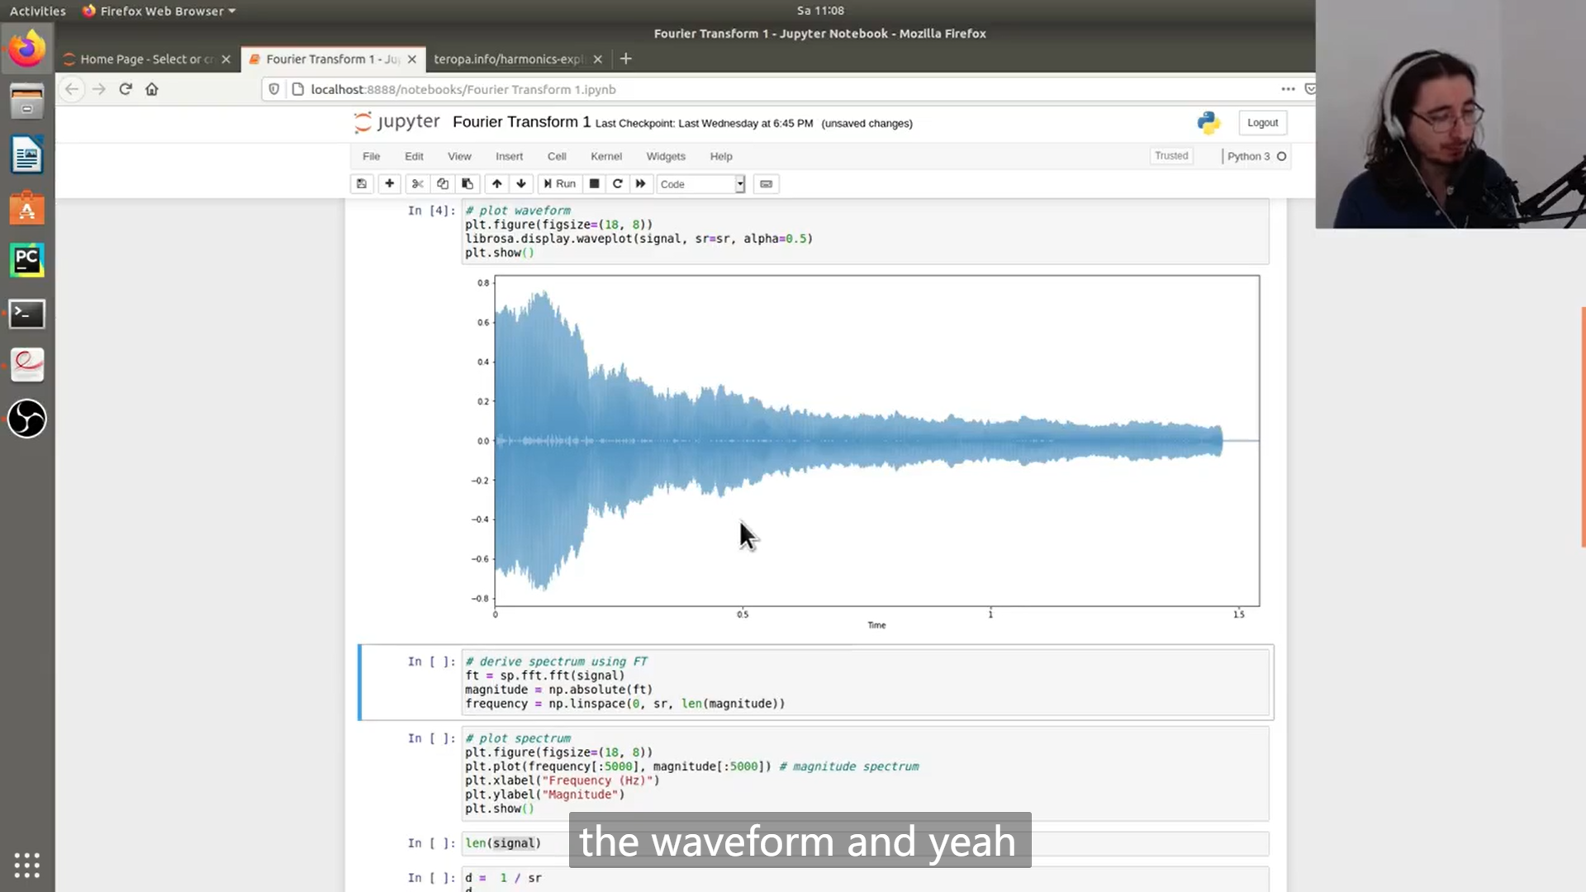

Slide 27
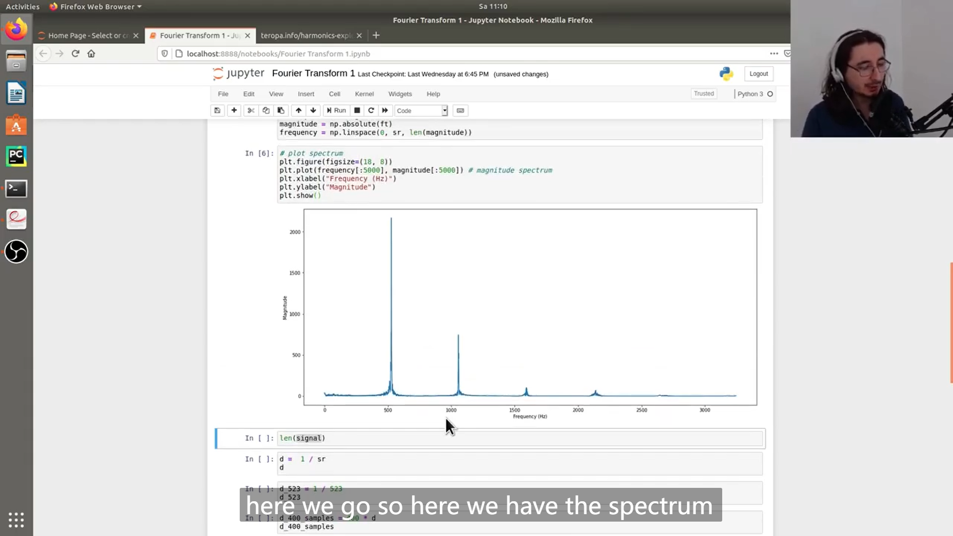

Slide 28
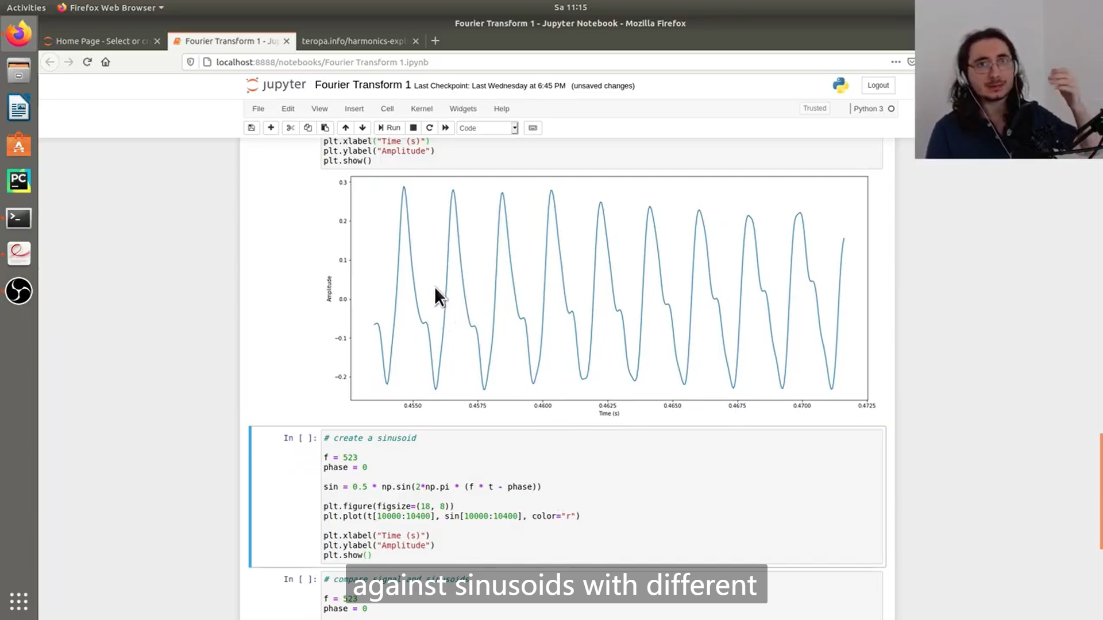

Slide 29
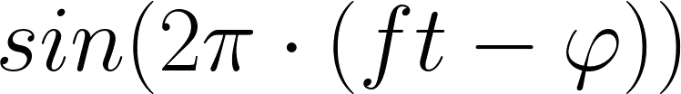
Sine wave

Slide 30
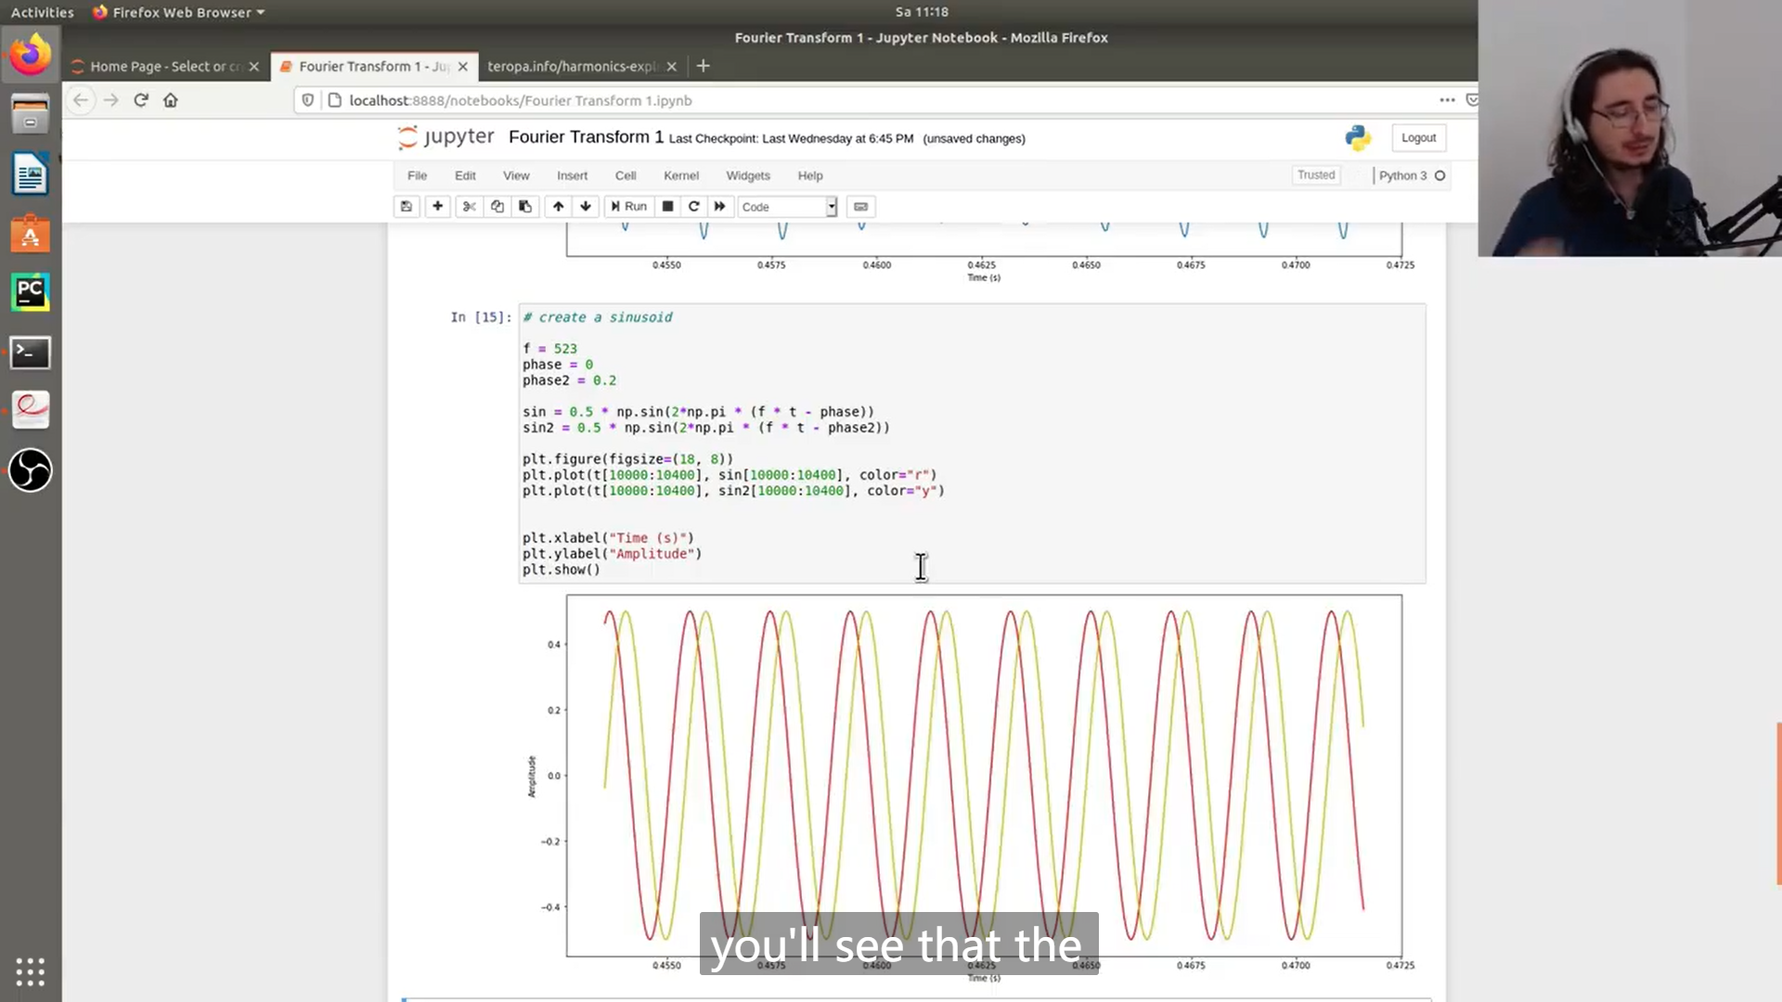

Slide 31
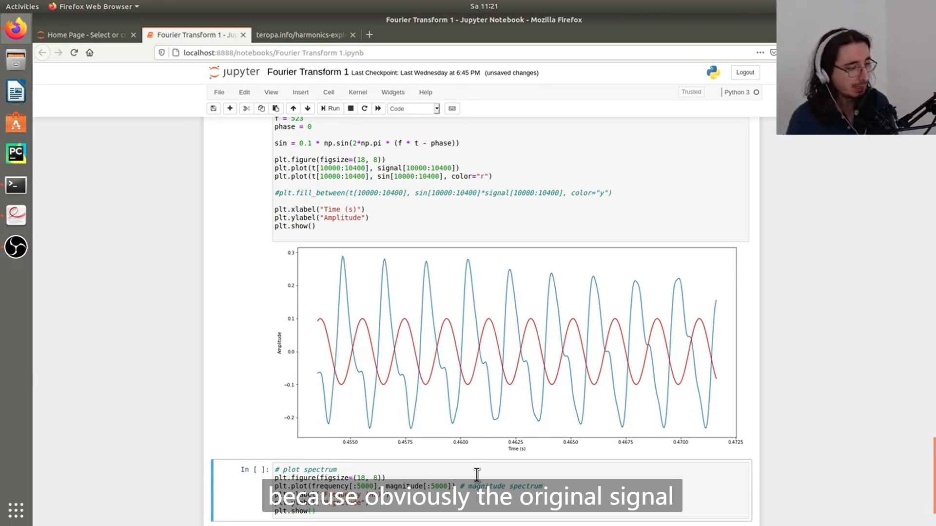

Slide 32
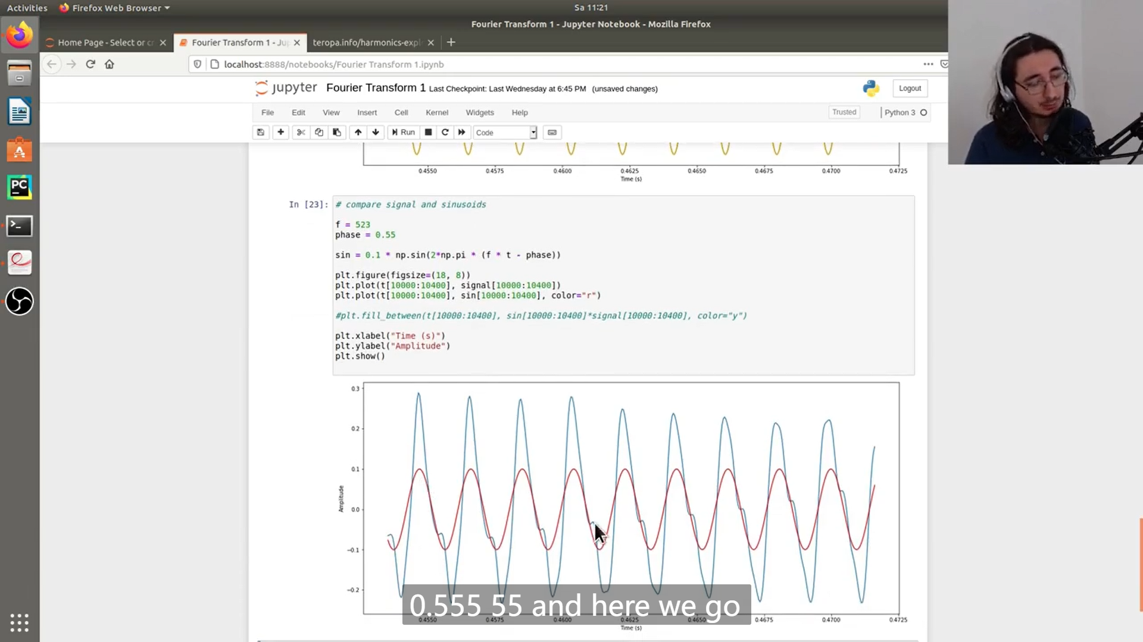

Slide 33
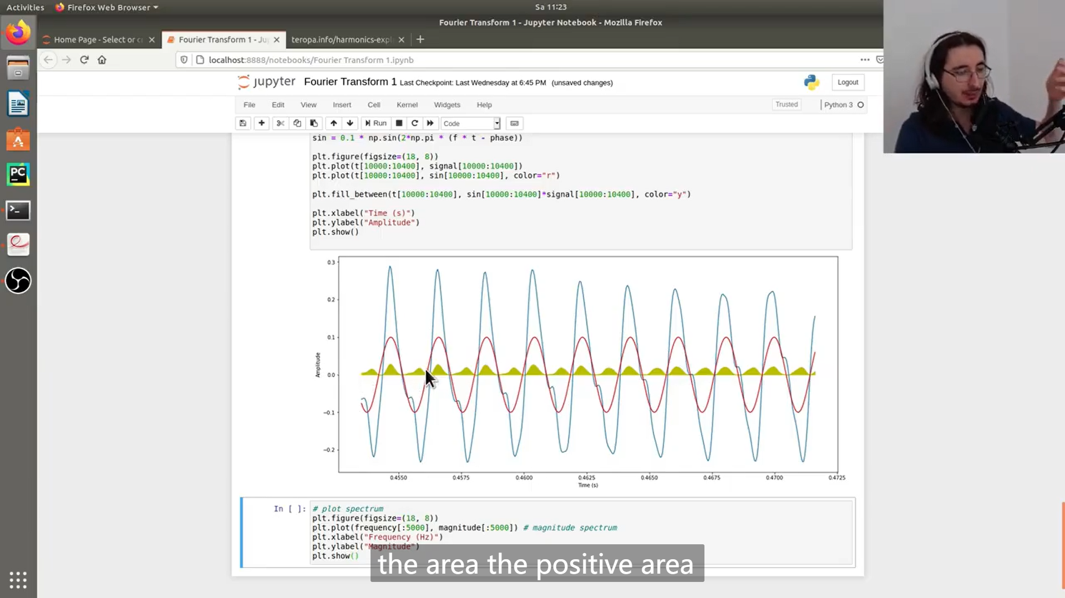

Slide 34
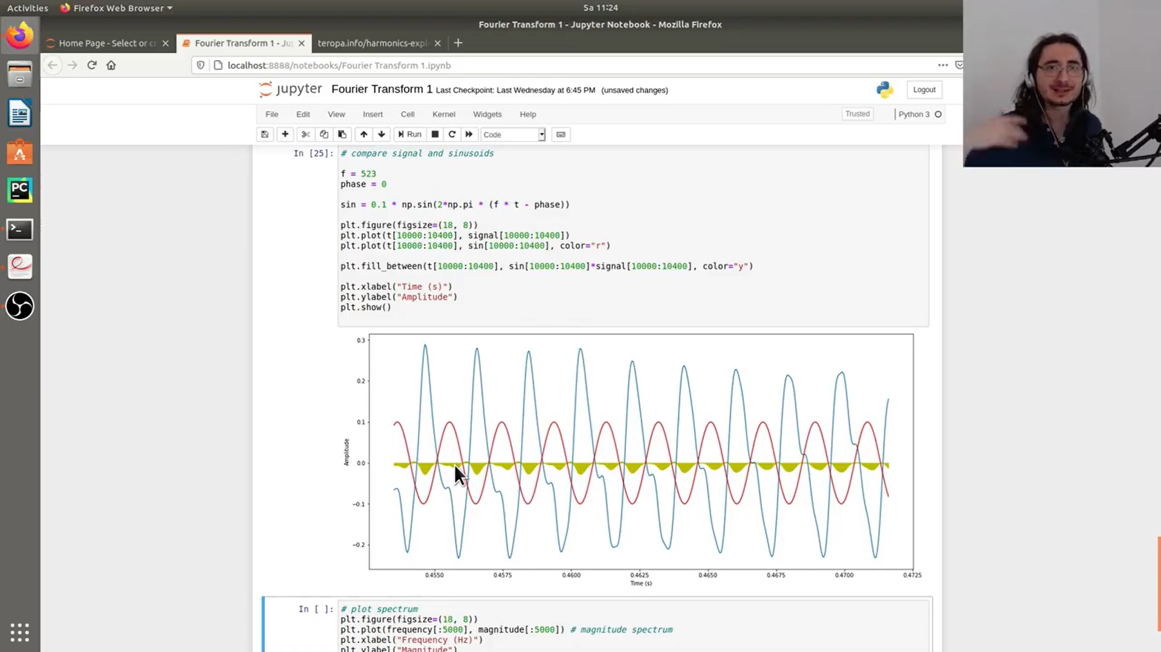

Slide 35
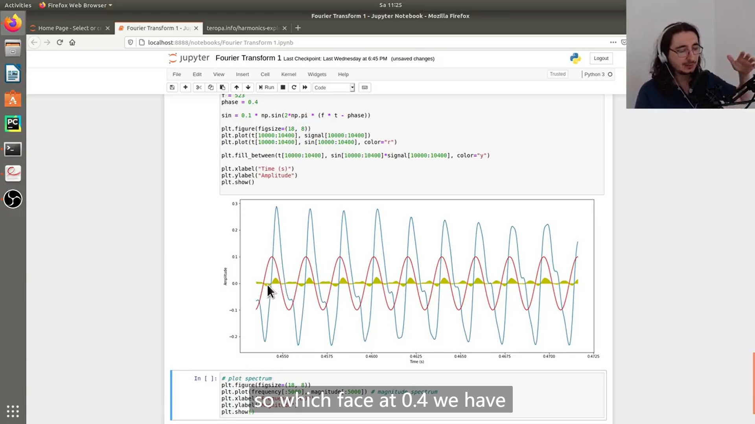

Slide 36
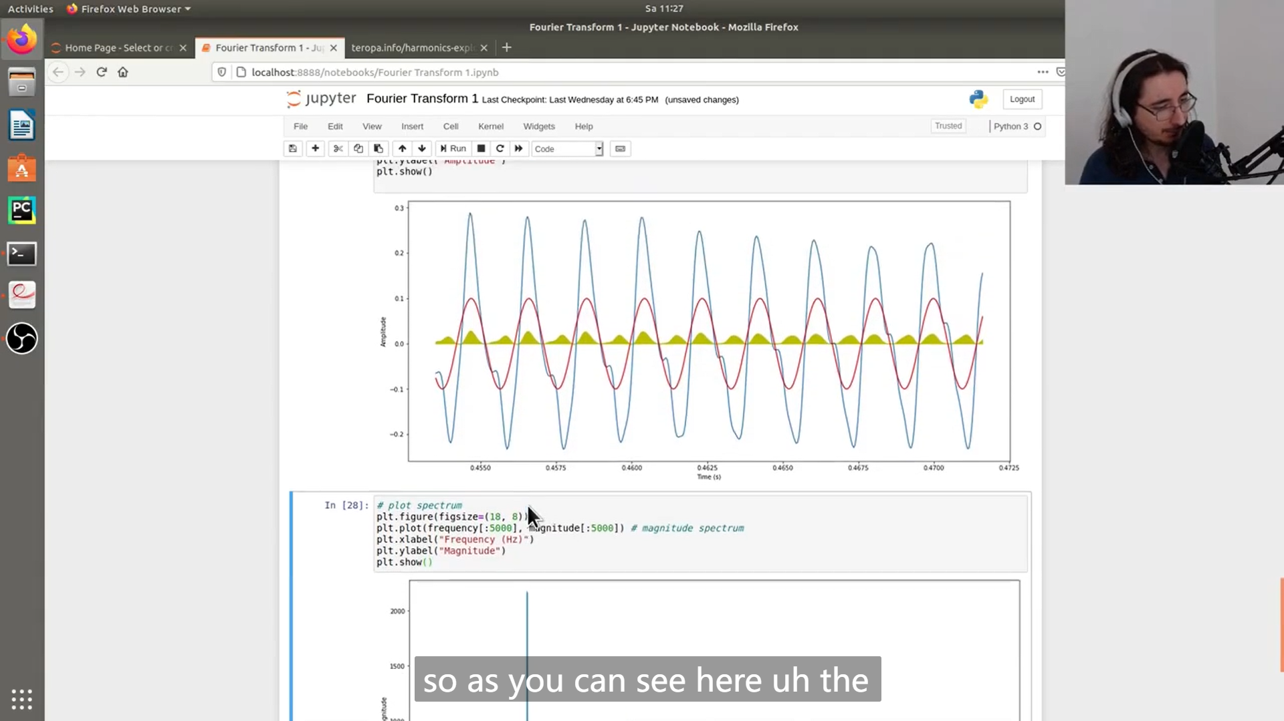

Slide 37
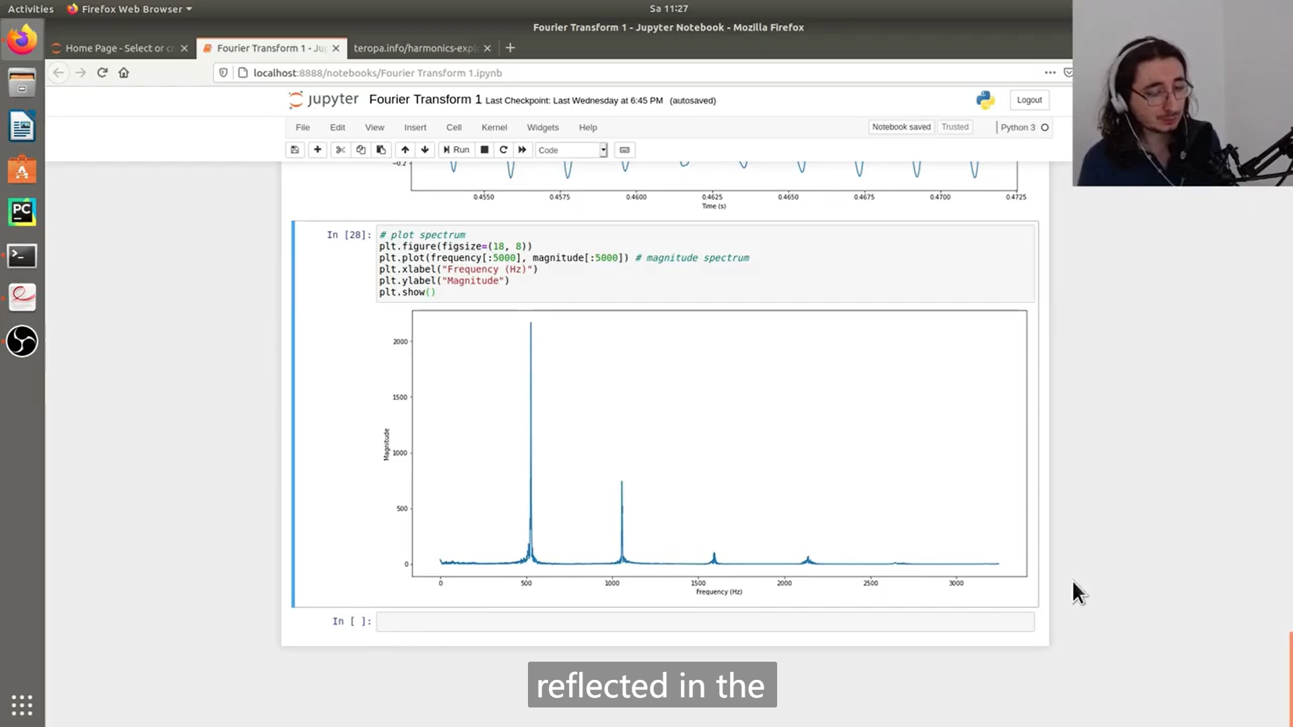

Slide 38
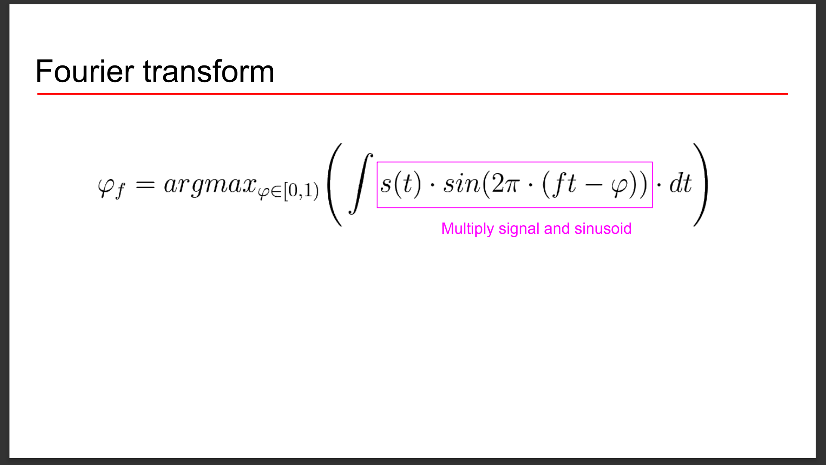

Slide 39
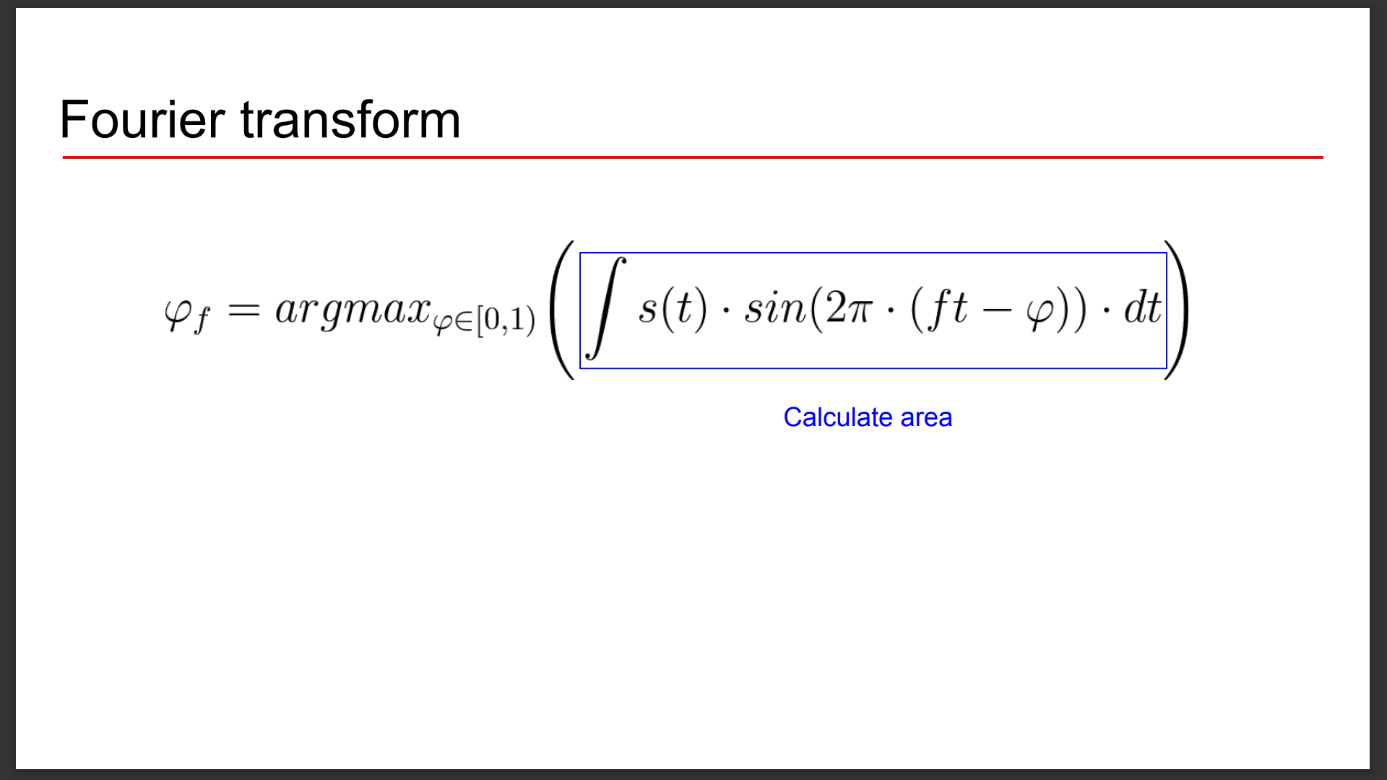

Slide 40
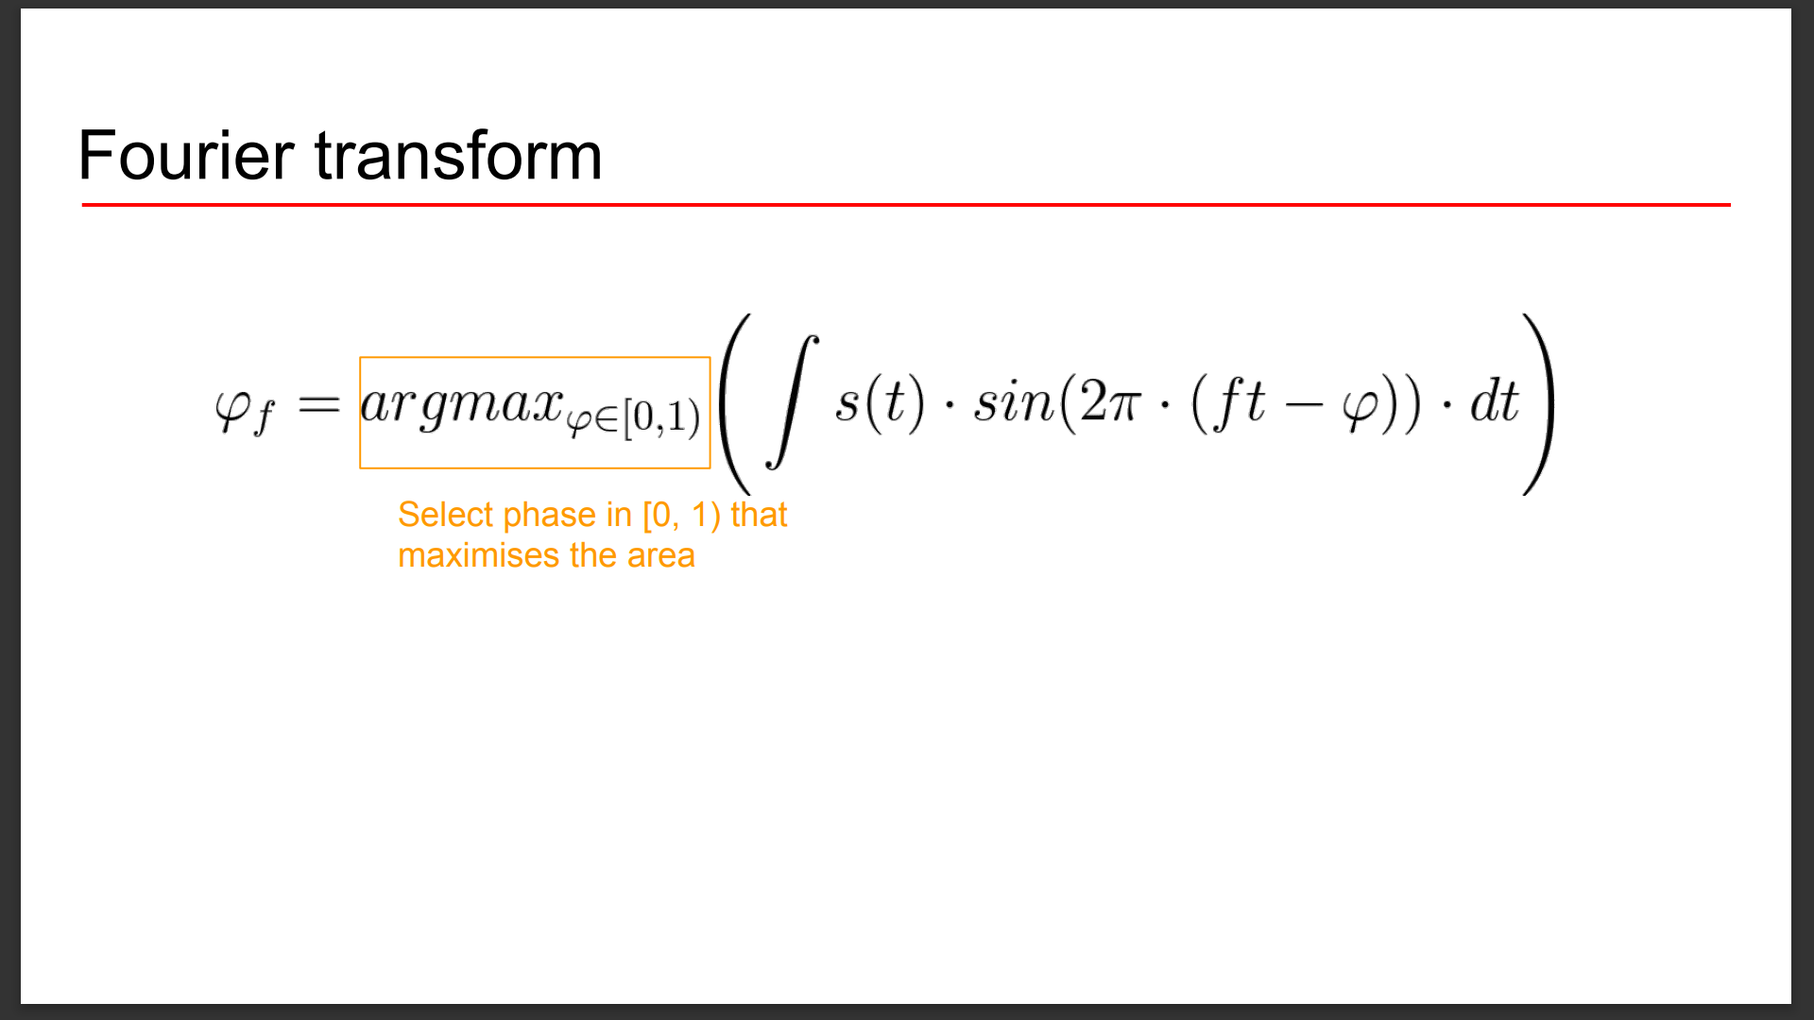

Slide 41
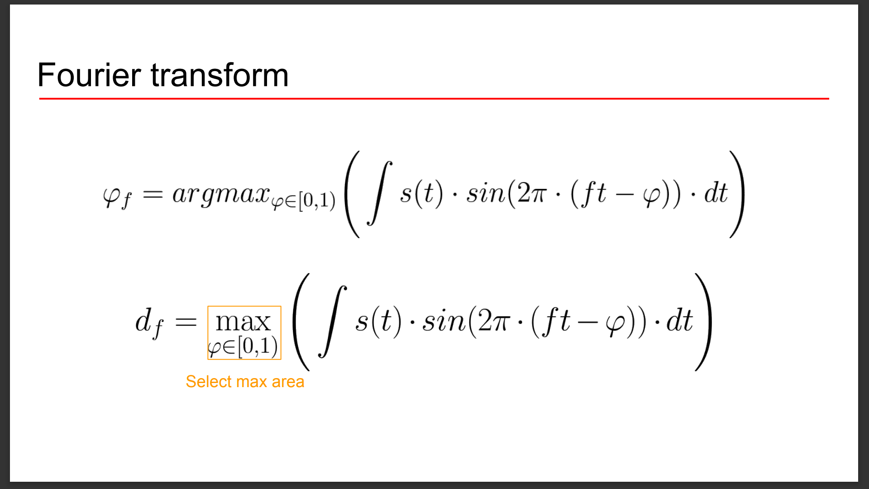

Slide 42
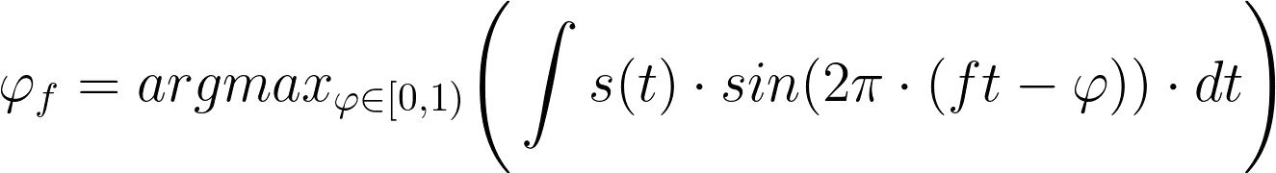
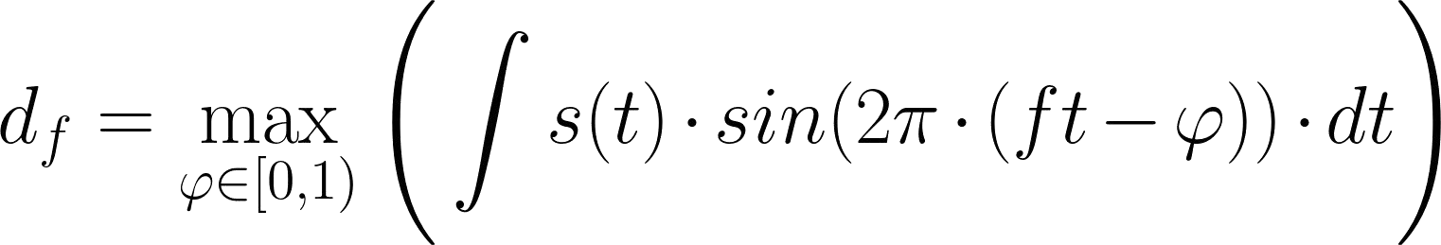
Fourier transform

Slide 43
Inverse Fourier transform
IFT

Slide 44
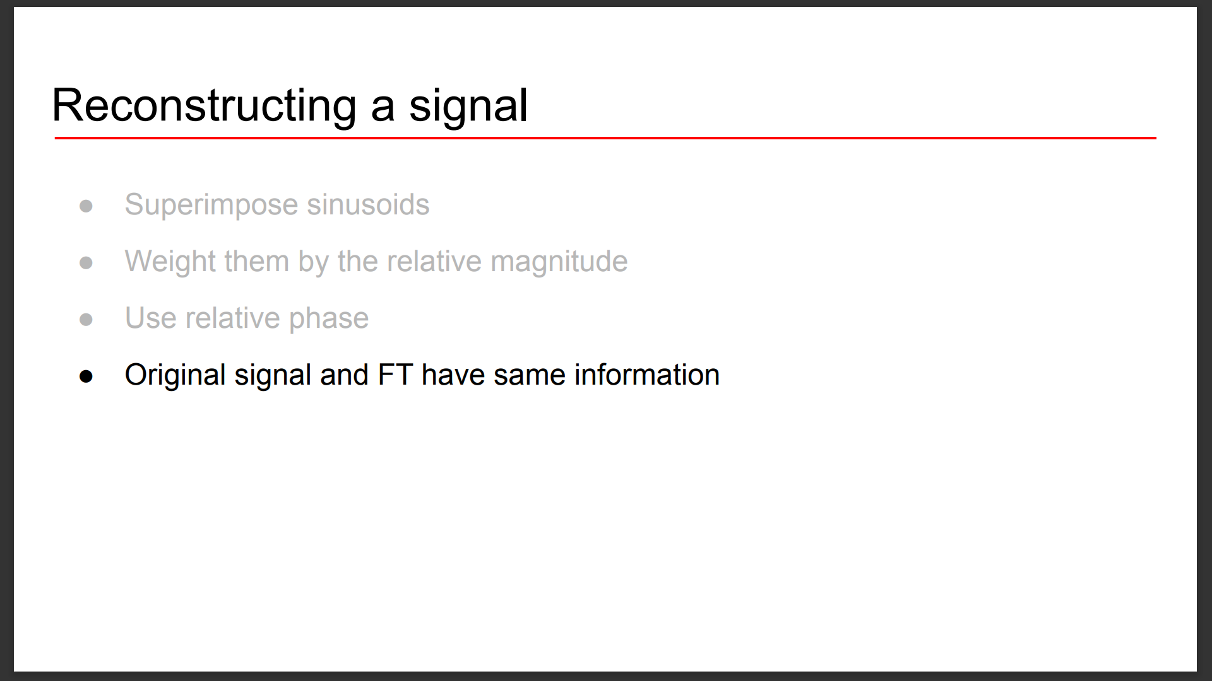

Slide 45
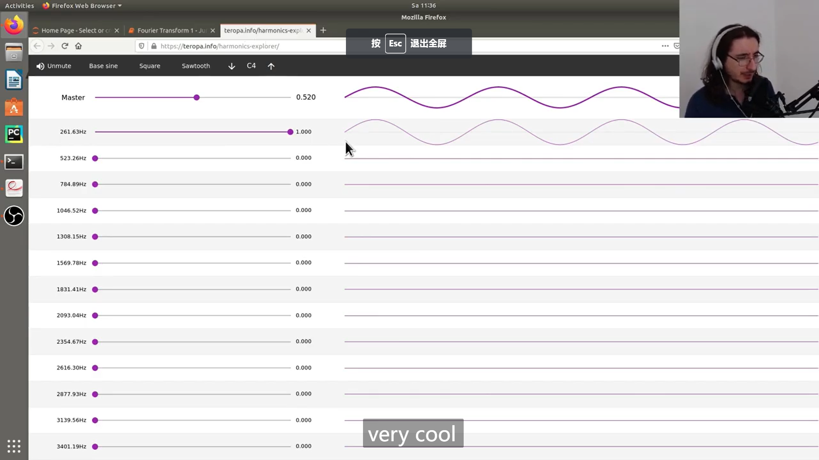
https://teropa.info/harmonics-explorer/

Slide 46
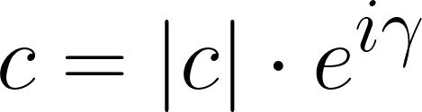
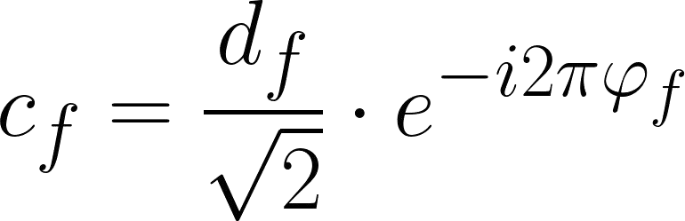
Complex Fourier transform coefficients

Slide 47
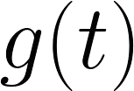
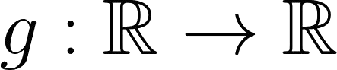
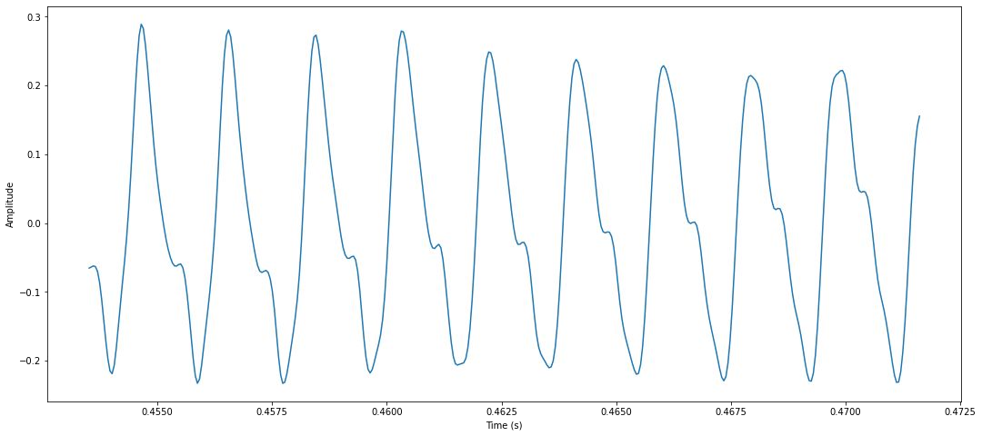
Continuous audio signal

Slide 48
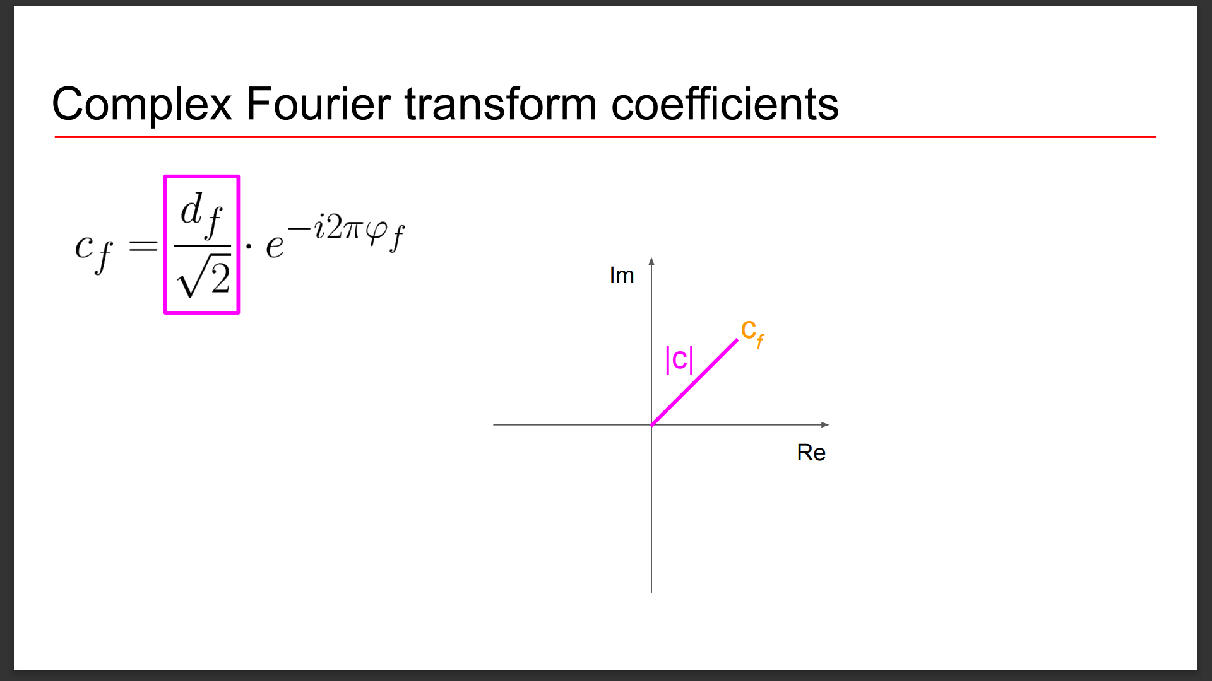

Slide 49
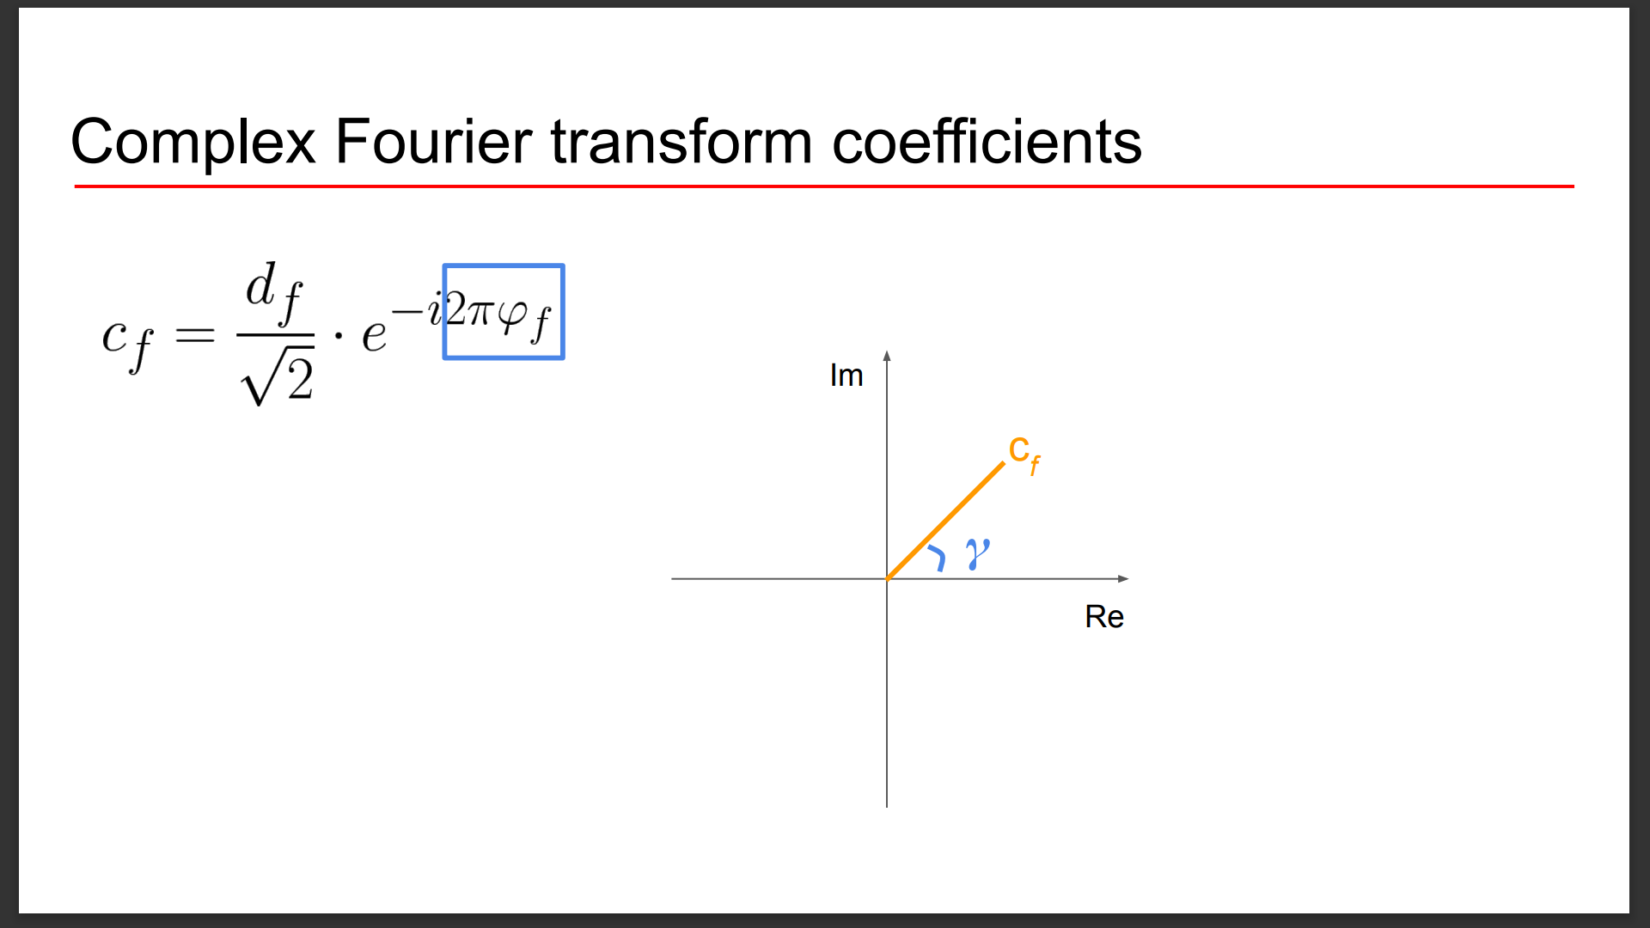

Slide 50
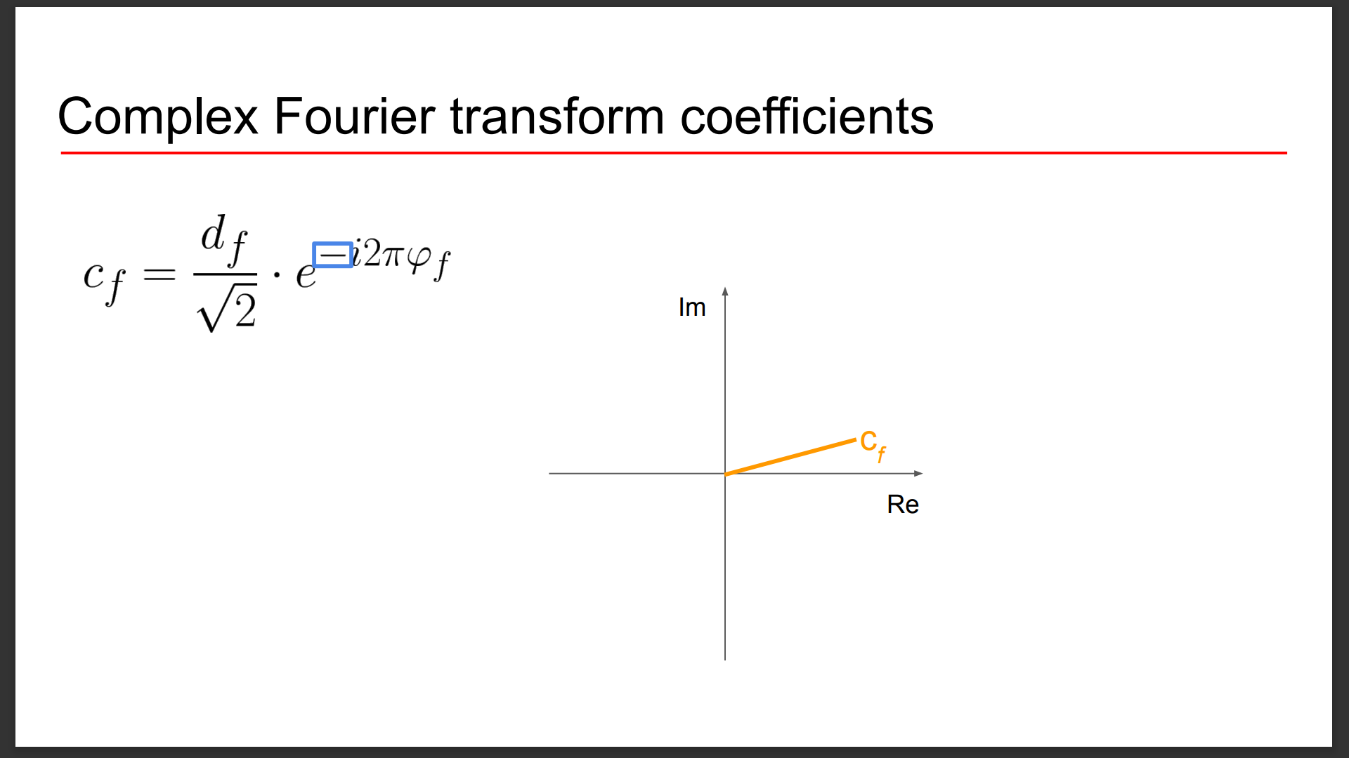

Slide 51
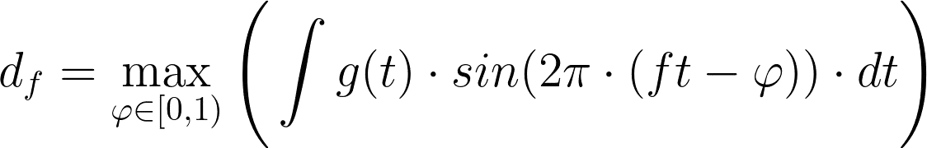

Complex Fourier transform
Im
c_{f}
Re

Slide 52


Slide 53


Slide 54


Slide 55


Slide 56


Slide 57


Slide 58


Slide 59


Slide 60


Slide 61


Slide 62


Slide 63


Slide 64


Slide 65


Slide 66


Slide 67


Slide 68
Complex Fourier transform
Real part
Imaginary part

Slide 69


Magnitude and phase

Slide 70
Inverse Fourier transform
IFT

Slide 71


Slide 72


Slide 73


Slide 74


Slide 75


A Fourier roundtrip

Slide 76


Digital signal

Slide 77

Building a discrete Fourier transform

Slide 78

DFT: Visual interpretation

Slide 79

Spectrogram

Slide 80
人工智能与听觉
听觉基础
语音的产生与感知
傅里叶变换：从时域到频域
抽取声音特征
典型的听觉任务与模型

Slide 81
We have a problem!
Humans perceive frequency logarithmically

Slide 82
Ideal audio feature
Time-frequency representation
Perceptually-relevant amplitude representation
Perceptually-relevant frequency representation
Mel spectrograms

Slide 83


Mel-scale
Logarithmic scale
Equal distances on the scale have same “perceptual” distance
1000 Hz = 1000 Mel

Slide 84


Slide 85


Slide 86


Slide 87


Slide 88


Slide 89


Slide 90


Slide 91


Slide 92


Slide 93


Slide 94


Slide 95

Mel spectrogram

Slide 96
Mel spectrogram applications
Audio classification
Automatic mood recognition
Music genre classification
Music instrument classification
...

Slide 97

Computing the cepstrum

Slide 98


Visualising the cepstrum
Signal
Power spectrum
DFT

Slide 99

Visualising the cepstrum
Power spectrum
Log power spectrum
log

Slide 100


Visualising the cepstrum
Log power spectrum
Cepstrum
IDFT
1st rhamonic

Slide 101

The vocal tract
Vocal tract acts as a filter

Slide 102

Speech generation

Slide 103

Understanding the cepstrum
Log-spectrum
dB
Speech
Spectral envelope
Vocal tract frequency response
Spectral detail
Glottal pulse
Hz

Slide 104
Speech
=
Convolution of vocal tract frequency response with
glottal pulse

Slide 105

Formalising speech

Slide 106
Formalising speech
Speech
Vocal tract frequency response
d B
Glottal pulse
Hz

Slide 107



The goal: Separating components

Slide 108

Separating components
IDFT
quefrency
d B
Hz

Slide 109
Computing Mel-Frequency Cepstral Coefficients
Waveform
DFT
Log-Amplitude Spectrum
Mel-Scaling
Discrete Cosine Transform
MFCCs

Slide 110
How many coefficients?
Traditionally: first 12 - 13 coefficients
First coefficients keep most information (e.g., formants, spectral envelope)
Use Δ and ΔΔ MFCCs
Total 39 coefficients per frame

Slide 111

Visualising MFCCs
# frames
# coefficients

Slide 112
MFCCs advantages
Describe the “large” structures of the spectrum
Ignore fine spectral structures
Work well in speech and music processing

Slide 113
参考书目
Valerio Velardo, Audio Signal Processing for Machine Learning: https://www.youtube.com/watch?v=iCwMQJnKk2c&list=PL-wATfeyAMNqIee7cH3q1bh4QJFAaeNv0
Daniel Jurafsky & James H. Martin, Speech and Language Processing
李航，统计学习方法，清华大学出版社

